Slide 1
Learning Outcome 2 – Assignment
LO2: Making your interactive multimedia product
You need to complete the following tasks in order to effectively create the multimedia product for ‘Out and Up’.
Assignment Tasks (P, M, D)
1 | You are now ready to create your multimedia product: Create your product by carrying out the following activities: Import your components into your chosen editing software Create the interactive multimedia product that you have planned Test your product as you develop it and on completion, to ensure that it works as intended If any information changes as you are creating the multimedia project, or you collect any additional components, etc. Make sure that you make the necessary changes to your planning documents or evidence these change in the test table along with reasons for the changes.
1
Purpose and audience Appropriate software Multimedia product Alternative pathways Multimedia components Clear evidence Effective testing Appropriate choices

Slide 2
Learning Outcome 2 – Task 1
LO2: Making your interactive multimedia product
You need to complete the following tasks in order to effectively create the multimedia product for ‘Out and Up’.
Task 1 (P, M, D) Use various editing software to combine components that you have collected.
1 | Use graphics-editing software to create a logo for ‘Out and Up’. This should include some of the images you collected along with text and various effects to enhance the appropriateness of the graphic.
2 | Provide annotated screenshots showing that you have done this, including some of the techniques that you have used.
 | Remember: ‘Out and Up’ is a company that runs team-building exercises for young adults. The company has recently bought a small plot of woodland and has set up an activity centre that includes an assault course and a café.
Graphics-editing software Purpose and audience Limited use of effects Clear house-style (M/D) Sound use of effects (M/D) Effective house-style (D) Effective use of effects (D)

Slide 3
Learning Outcome 2 – Task 2
LO2: Making your interactive multimedia product
You need to complete the following tasks in order to effectively create the multimedia product for ‘Out and Up’.
Task 2 (P, M, D) Use various editing software to combine components that you have collected.
1 | Use video conversion software to convert the videos that you collected into appropriate file types for use in your multimedia product.
2 | Provide annotated screenshots showing that you have done this, including some of the techniques that you have used.
 | Distinction* Only:
3 | Use video-editing software to enhance the videos that you are going to use in your multimedia product. Examples could include adding text, combining videos, adding the logo, editing the sound/music, etc.
Video conversion software Purpose and audience Limited use of effects Clear house-style (M/D) Sound use of effects (M/D) Effective house-style (D) Effective use of effects (D)

Slide 4
Learning Outcome 2 – Task 3
LO2: Making your interactive multimedia product
You need to complete the following tasks in order to effectively create the multimedia product for ‘Out and Up’.
Task 3 (P, M, D) Produce evidence of creating your interactive multimedia product.
1 | Create a template based on the house-style that you created in LO1. Example evidence of templates include: PowerPoint – Slide Master Websites – Template HTML and/or Cascading Style Sheets Mediator – Master Page
2 | Provide annotated screenshots showing that you have done this, including: the creation of a navigation system use of effects (i.e. transitions, custom animations, html, script, etc.) setup of any interaction necessary (i.e. triggers, hotspots, etc.)
 | Distinction Only:
3 | Effective house-style with navigation and advanced techniques that accurately reflects designs and consistently meets user requirements.
Template (house-style) Navigation system Basic interactivity Limited use of effects Clear house-style (M/D) Sound interactivity, navigation and effects (M/D) Accurate house-style (D) Effective interactivity, navigation and effects (D)

Slide 5
Learning Outcome 2 – Task 4
LO2: Making your interactive multimedia product
You need to complete the following tasks in order to effectively create the multimedia product for ‘Out and Up’.
Task 4 (P, M, D)
1 | Create your interactive multimedia product based on the storyboards that you created in LO1. When creating the product make sure that you include: Multimedia elements i.e. images, sounds, animations and videos Alternative pathways i.e. menu, hotspot/hyperlinked logo/images, etc. Appropriate working navigation including sub-menus (if necessary). User interaction i.e. Roll over, drag and drop, input form, behaviours, triggers, collision, scripting, hot spots, actions, etc. Effects i.e. transitions, html, fade in, fade out, custom animation, etc.
2 | Printout and annotate the multimedia product, making sure that it matches your storyboards and that it meets you success criteria.
 | Merit and Distinction:
3 | Create a test table and provide tests during the creation of the product, i.e. house style matches design, navigation system works, images are appropriate and in proportion, videos and sounds work as intended, etc.
Storyboards Alternative pathways Navigation and menus User interaction and effects Use of multimedia elements (i.e. images, sounds, animations and videos) Clear house-style (M/D) Sound interactivity, navigation and effects (M/D) Appropriate testing (M/D) Accurate house-style (D) Effective interactivity, navigation and effects (D)

Slide 6
Learning Outcome 2 – Task 5
LO2: Making your interactive multimedia product
You need to complete the following tasks in order to effectively create the multimedia product for ‘Out and Up’.
Task 5 (P, M, D) Produce evidence of creating your interactive multimedia product.
1 | Evidence your alternative pathways, including menus, sub-menus and hyperlinks, image hyperlinks (e.g. logo) and/or hotspots etc.
2 | Provide screenshot evidence of this.
 | Remember: “that the advertising must use a range of interactivity and effects to create an advert that appeals to the target audience, is visually exciting and leads to bookings being made at the new centre.”
 | Merit and Distinction:
3 | Make sure that you use a variety of alternative pathways that are effective and follow a consistency throughout the product (i.e. All logos link to the homepage or menus and sub-menus follow a consistent house style)
Menu Sub-menu Hyperlinks (M/D) Image hyperlinks and/or hotspots (D) Consistent house-style (D)

Slide 7
Learning Outcome 2 – Task 6
LO2: Making your interactive multimedia product
You need to complete the following tasks in order to effectively create the multimedia product for ‘Out and Up’.
Task 6 (P, M, D) Produce evidence of creating your interactive multimedia product.
1 | Evidence user interactive features within your multimedia product. i.e. roll over, drag and drop, input form, behaviours, triggers, collision, scripting, hotspots, actions, QR Code, print macros, mouse-over, etc.
2 | Provide screenshot evidence of this.
 | Remember: “that the advertising must use a range of interactivity and effects to create an advert that appeals to the target audience, is visually exciting and leads to bookings being made at the new centre.”
 | Merit and Distinction:
3 | Make sure that all interactive features are appropriate and that they enhance the overall interactivity of the presentation while following a consistent house style throughout (i.e. all logos have a mouse over action).
Animation Triggers Hyperlinks and/or hotspots to external websites Actions – mouse over (M/D) QR – http://goqr.me/ (M/D) Actions – run macro i.e. to print the booking/prices (D) Consistent house-style (D)

Slide 8
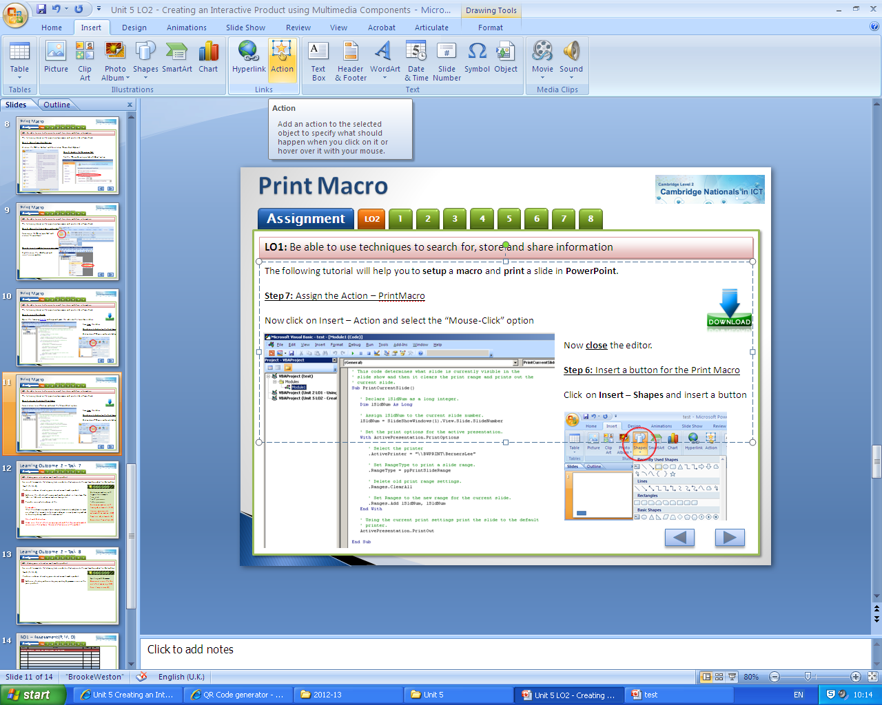
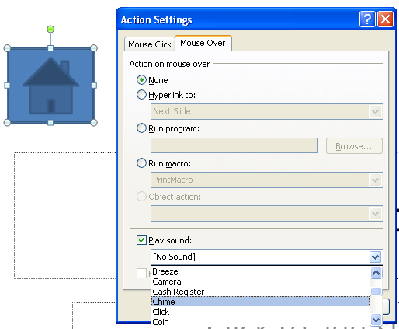
Action – Mouse Over
LO1: Be able to use techniques to search for, store and share information
The following tutorial will help you to setup a action – mouse over.
Step 1: Click on the object and open actions
Click on the object that you would like to create the mouse-over action on, and then click on “Insert – Action”.
In this example I am going to make a sound when the user hovers over a button.
- Click on “Mouse Over”...
- Then “Play Sound” and select a sound of your choice.
You now have an interactive mouse-over action!

Slide 9
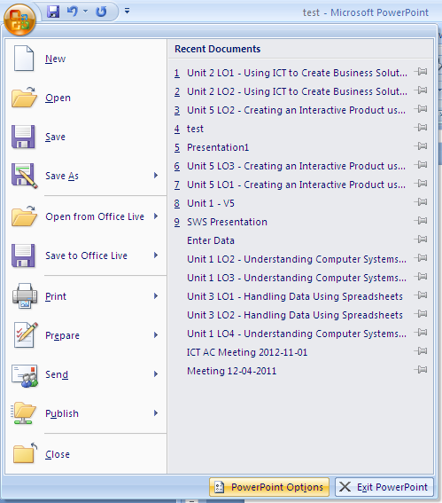
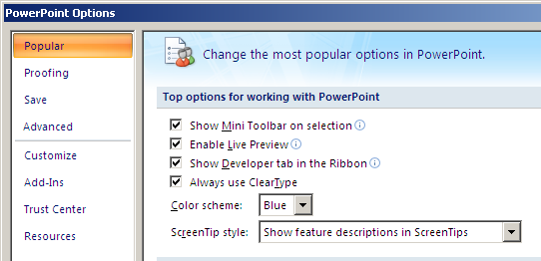
Print Macro
LO1: Be able to use techniques to search for, store and share information
The following tutorial will help you to setup a macro and print a slide in PowerPoint.
Step 1: Open PowerPoint Options
Click on the “Office Button” and then click on “PowerPoint Options”
Step 2: Enable the “Developer Tab”
Tick the “Show Developer tab in Ribbon” option

Slide 10
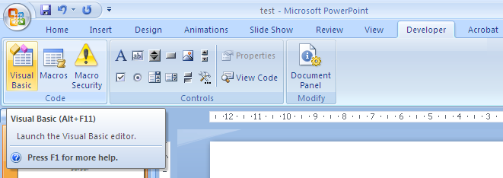
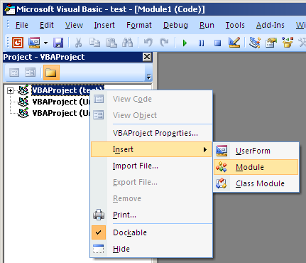
Print Macro
LO1: Be able to use techniques to search for, store and share information
The following tutorial will help you to setup a macro and print a slide in PowerPoint.
Step 3: Open the “Visual Basic” code editor
Now open the “Developer Tab” and
click on “Visual Basic”
Step 4: Insert a module to use as your macro
Right-click on the VBAProject and
insert a new module

Slide 11

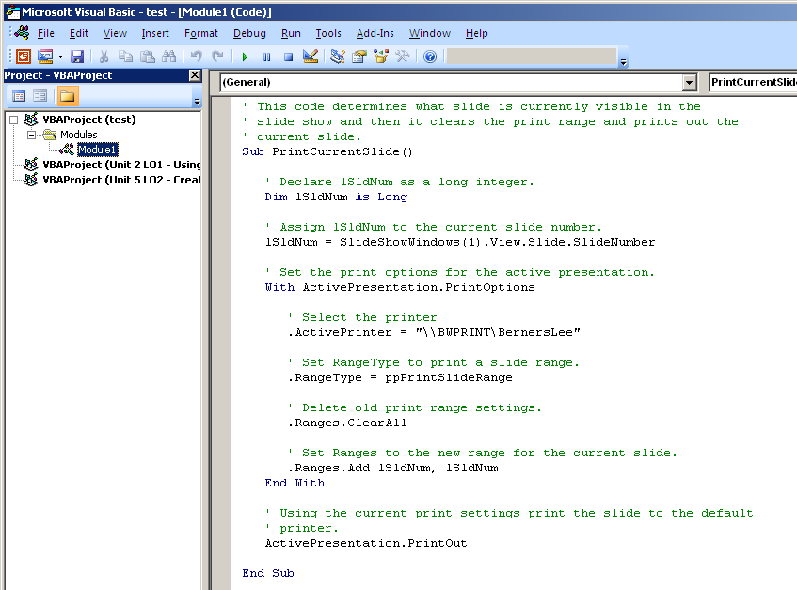
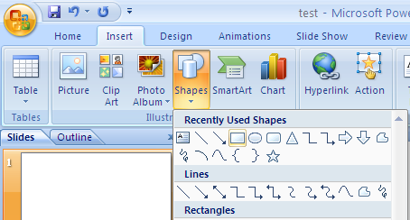
Print Macro
LO1: Be able to use techniques to search for, store and share information
The following tutorial will help you to setup a macro and print a slide in PowerPoint.
Step 5: Insert the VB code
Open the following file and use the screenshot as evidence of collecting the code,
but copy and paste the code from the file into the Visual Basic editor.
Change the \\BWPRINT\BernersLee to match the your classes printer and close the editor.
Step 6: Insert a button for the Print Macro
Open Click on Insert – Shapes and insert a button

Slide 12
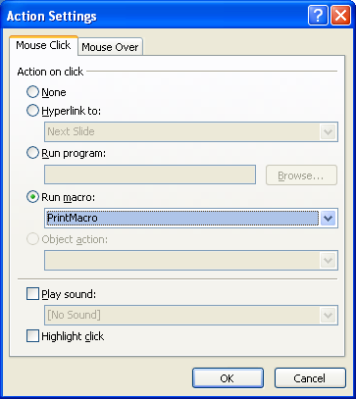
Print Macro
LO1: Be able to use techniques to search for, store and share information
The following tutorial will help you to setup a macro and print a slide in PowerPoint.
Step 7: Assign the Action – PrintMacro
Now click on Insert – Action
- Make sure that you select “Mouse-Click” and then “Run Macro” – PrintMacro
- Now click on “OK” and the macro should work allowing you to PRINT!
Step 8: Label the button and test it!
Finally “Edit the Text” of the Button appropriately (right-click edit text) .

Slide 13
Learning Outcome 2 – Task 7
LO2: Making your interactive multimedia product
You need to complete the following tasks in order to effectively create the multimedia product for ‘Out and Up’.
Task 7 (P, M, D) Produce evidence of creating your interactive multimedia product.
1 | Evidence the effects within your multimedia product. i.e. transitions, html, fade in, fade out, custom animation, timings, etc.
2 | Provide screenshot evidence of this.
 | Remember: “that the advertising must use a range of interactivity and effects to create an advert that appeals to the target audience, is visually exciting and leads to bookings being made at the new centre.”
 | Merit and Distinction:
3 | Make sure that all effects are appropriate and that they use automated sequences that enhance the overall effectiveness of the product.
Custom animation with triggers for example: - on click - with previous - after previous Custom animation with timing adjustments (M/D) Various appropriate automated animation (M/D) Timeline adjustments (D) Consistent house-style (D)

Slide 14
Learning Outcome 2 – Task 8
LO2: Making your interactive multimedia product
You need to complete the following tasks in order to effectively create the multimedia product for ‘Out and Up’.
Task 8 (P, M, D) Produce evidence of creating your interactive multimedia product.
1 | Evidence checking and correcting any spelling & grammar errors within your product.
Spelling and Grammar Occasional errors that do not affect meaning (M/D) Few, if any, errors (D)

Slide 15
AO1 – Assessment (P, M, D)
Task | Activities | Student | Peer
Create an appropriate Bitmap and Vector graphic for BW Travel

